Slide 1

Lead your Property Business from the Heart

Slide 2
What is the problem?
People are in emotional pain how do we help them

Slide 3
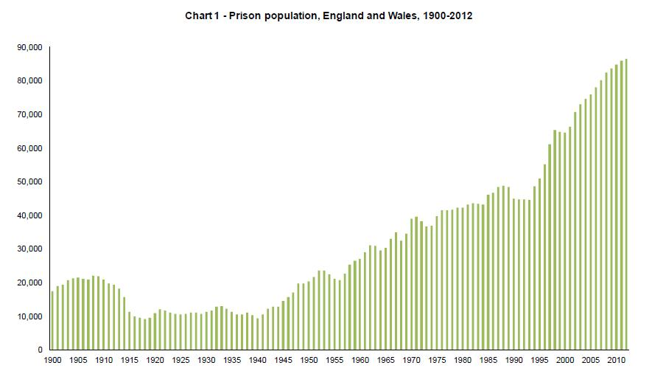
Stats
9% Men addicted to alcohol
15.6% have experimented with Class A drugs
Extracted from: House of commons: Library

Slide 4
Marriages
100
Divorce (55%)
45
Kids and finances (50%)
23
1000’s of couples [Gregs estimate]
1%-2% really end up happy (1 measure)

Slide 5
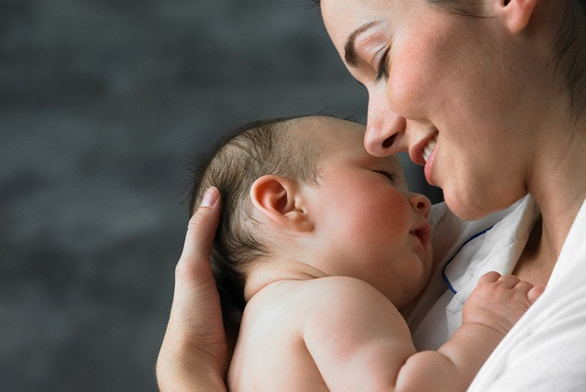

Slide 6
REAL Happiness
People want to be happy but they don’t find it...
Why?
They have NO idea what ‘happy’ REALLY is
AND
They are not willing to pay the price to find it.

Slide 7
Definition of REAL Love™
Caring about somebody else’s happiness
without wanting ANYTHING from them in return

Slide 8
What Real Love is NOT
Not the first 6 months of a relationship (honeymoon period)
Not comfort
Not giving people what they want
Not a romantic movie
Not sex (only part of a loving relationship)
Not the food you LOVE
You don’t get it from your kids

Slide 9
Without REAL Love vs With REAL Love
Insufficient Love
Empty and Afraid
Pain
REAL Love
No Emptiness and Fear
No Pain

Slide 10
3 Ingredients of REAL Happiness
Feeling ‘REAL’ Loved
‘REAL’ Loving others
Being Responsible
REAL Happiness – has to be earned

Slide 11
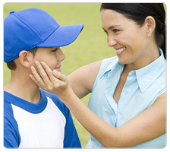
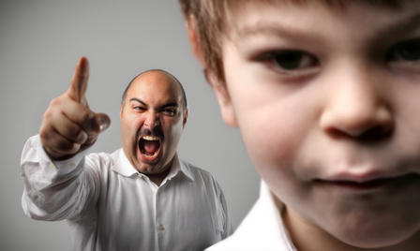
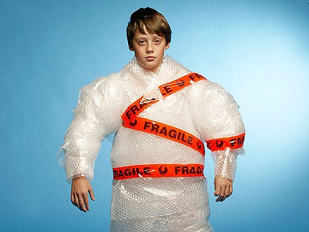
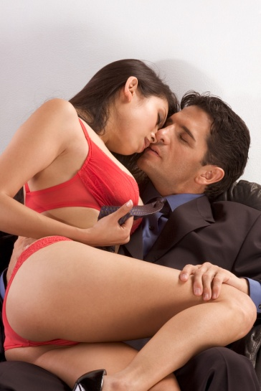
Imitation Love
Praise
Power
Pleasure
Safety

Slide 12
Praise
Feels GREAT for a moment
Currency to get it is what you DO and how you LOOK
More more more
Not about me but about how we make others feel

Slide 13
Power
Pain relief
Feeling that we get when we control another person
Less helpless
Connection
Parents

Slide 14
Pleasure
Hurts to not feel loved
Anything that will distract us
Holidays, cars, money, sex, drugs, shopping, food, alcohol
We get addicted to our pleasures
Pleasure only bad when no Real Love

Slide 15
Safety
Alleviation of pain
Confused with love
Financial Security
All of our lives trying to get something that will never make us happy

Slide 16

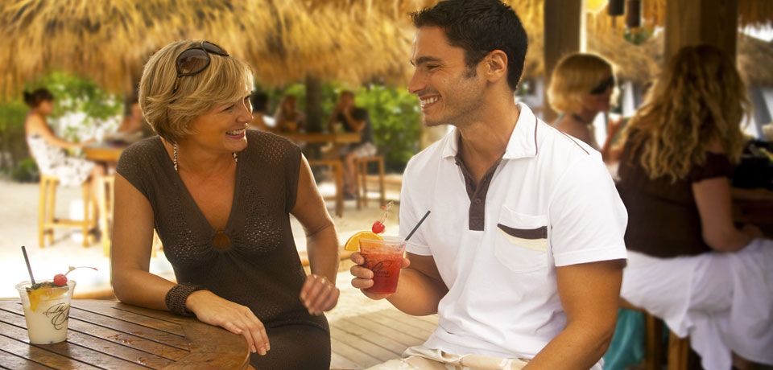
IL Explored

Slide 17
Exercise
Work with a partner
Discuss where you have used TWO different imitation loves

Slide 18
Emptiness
Fear
Getting Behaviours
Protecting Behaviours
Lying
Attacking
Acting like a victim
Clinging
Lying
Attacking
Acting like a victim
Running

Slide 19
Understanding Getting and Protecting Behaviours allows us to:-
Understand almost ALL human behaviour
Understand our interactions and relationships
Understand why you often don’t feel loved
Change how we see, feel about, and respond to others
Avoid repeating the same unproductive behaviours

Slide 20
How to FEEL loved
Truth
Seen
Accepted
Loved

Slide 21
Exercise – Truth Telling
What you did
What they did
Why you did it
What can you do now
What can you do next time

Slide 22
Web: www.realloveuk.com
E-mail: ben@realloveuk.com
Tel: 07834608501

